Slide 1
Predict a new movie s IMDB Score by using k-Nearest Neighbor Algorithm
MIS 637 Knowledge Discovery & Data Mining; 2013 Fall
Prof. M. Daneshmand
Wei Du
wdu3@stevens.edu

Slide 2



Why this Topic?
I am a Movie lover.
I recently won a free movie tickets
I can t decide which to see…

Slide 3
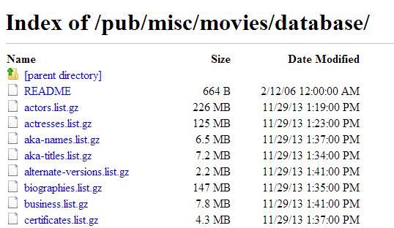
Dataset
From website: http://www-958.ibm.com/software/data/ cognos/manyeyes/datasets/movie-database-4/versions/1
From IMDB data base:
The data I got include: Title; Studio; Genre; Budget; MPAA; imdb UserRating; Opening Date; Opening Theaters; Opening Weekend; Widest Release; Closing Date; Total Gross; Tickets Sold.
13 variables

Slide 4

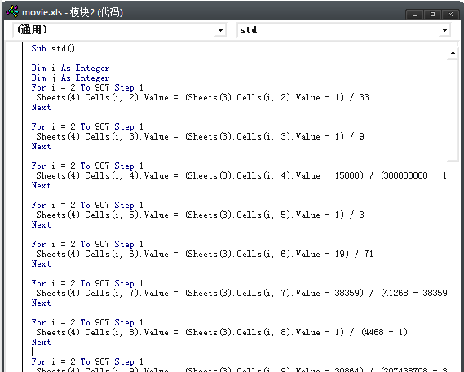

Data example
Title | Studio | Genre | Budget | MPAA | imdb Score
(500) Days of Summer | Fox Searchlight | Romantic Comedy | $ 7,500,000.00 | PG-13 | 76
10,000 B.C. | Warner Bros. | Adventure | $ 105,000,000.00 | PG-13 | 49
12 Rounds | 20th Century Fox | Action | $ 20,000,000.00 | PG-13 | 55
127 Hours | Fox Searchlight | Drama | $ 18,000,000.00 | R | 77
Opening Date | Opening Theaters | Opening Weekend | Widest Release | Closing Date | Total Gross | Tickets Sold
2009/8/7 | 27 | $ 834,501.00 | 1048 | 2009/11/22 | $ 32,425,665.00 | 4323422
2008/3/7 | 3410 | $ 35,867,488.00 | 3454 | 2008/6/19 | $ 94,784,201.00 | 13201142
2009/3/27 | 2331 | $ 5,329,240.00 | 2331 | 2009/6/11 | $ 12,234,694.00 | 1631293
2010/8/20 | 137 | $ 199,657.00 | 33 | 2010/12/9 | $ 18,335,230.00 | 2318806
I use excel and VBA to solve this problem

Slide 5
Prepare data
Replace all character variables into number.
Title | Studio | Genre | Budget | MPAA | imdb Score | Opening Date
WALL-E | 1 | 2 | 180000000 | 1 | 85 | 39626.00
Cars 2 | 1 | 2 | 200000000 | 1 | 63 | 40718.00
Toy Story 3 | 1 | 2 | 200000000 | 1 | 85 | 40347.00
Horton Hears a Who | 4 | 2 | 85000000 | 1 | 69 | 39521.00
Opening Theaters | Opening Weekend | Widest Release | Closing Date | Total Gross | Tickets Sold
3992.00 | 63087526.00 | 3992.00 | 39455 | 2.24E+08 | 31171046
4115.00 | 66135507.00 | 4115.00 | 40892 | 1.91E+08 | 24142607
4028.00 | 110307189.00 | 4028.00 | 40514 | 4.15E+08 | 52598844
3954.00 | 45012998.00 | 3961.00 | 39695 | 1.55E+08 | 21522206

Slide 6
Normalize data
Use Min-Max Normalization
Title | Studio | Genre | Budget | MPAA | imdb Score
WALL-E | 0 | 0.111111 | 0.59998 | 0 | 0.929577
Cars 2 | 0 | 0.111111 | 0.66665 | 0 | 0.619718
Toy Story 3 | 0 | 0.111111 | 0.66665 | 0 | 0.929577
Horton Hears a Who | 0.090909 | 0.111111 | 0.283297 | 0 | 0.704225
Opening Date | Opening Theaters | Opening Weekend | Widest Release | Closing Date | Total Gross | Tickets Sold
0.435545 | 0.893441 | 0.304023 | 0.893369 | 0.352659 | 0.284761 | 0.306815
0.810932 | 0.920976 | 0.318718 | 0.920923 | 0.81294 | 0.241639 | 0.234678
0.683396 | 0.9015 | 0.531688 | 0.901434 | 0.691864 | 0.539561 | 0.526741
0.39945 | 0.884934 | 0.216878 | 0.886425 | 0.429532 | 0.192435 | 0.207783

Slide 7

Our new data
Title | Studio | Genre | Budget | MPAA | imdb Score | Opening Date | Opening Weekend
The Hunger Games: Catching Fire | Universal | Thriller/Suspense | 130000000 | PG-13 | ? | 2013/11/11 | 158074286
 | 0.30303 | 0.888889 | 0.433305 | 0.666667 |  | 1.110347198 | 0.761993466
Title | Studio | Genre | Budget | MPAA | imdb Score | Opening Date | Opening Weekend
Thor: the dark world | Marvel | Action | 170000000 | PG-13 | ? | 2013/11/8 | 85737841
 | 0 | 0 | 0.566645 | 0.66667 |  | 1.109315916 | 0.413229198

Slide 8
Calculate Distance
 | Distance | imdb
The Bourne Ultimatum | 0.524494 | 81
The Da Vinci Code | 0.494597 | 64
The Hunger Games | 0.346873 | 72
 | Distance | imdb
X-Men Origins: Wolverine | 0.066751 | 67
Transformers | 0.096992 | 71
Iron Man | 0.081863 | 79
3 nearest nodes

Slide 9
Prediction
The method used to accomplish this is Locally Weighted Averaging

Slide 10

Prediction
Distance | IMDB | D(node,new)^2 | 1 D(node,new)^2 | IMDB D(node,new)^2 | Prediction
0.524494 | 81 | 0.275094 | 3.635122 | 294.4449
0.494597 | 64 | 0.244626 | 4.087875 | 261.624
0.346873 | 72 | 0.120321 | 8.311113 | 598.4001 | (72)
 |  |  | 16.03411 | 1154.469 | 72.00082
It shows that The ‘Hunger Game’ is slightly better than ‘Thor’
Distance | IMDB | D(node,new)^2 | 1 D(node,new)^2 | IMDB D(node,new)^2 | Prediction
0.066751 | 67 | 0.004456 | 224.4348 | 15037.13 | (67)
0.096992 | 71 | 0.009407 | 106.2996 | 7547.27
0.081863 | 79 | 0.006702 | 149.2178 | 11788.2
 |  |  | 479.9522 | 34372.61 | 71.61673

Slide 11
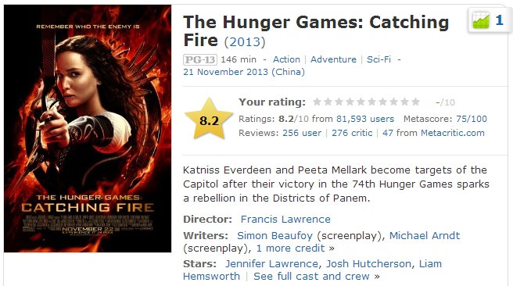

What’s in IMDB
8.2>7.6
The Hunger Game Win!
As time goes, movie score on IMDB will slowly drop. So the prediction is reasonable.

Slide 12
Conclusion
The model using k-Nearest Neighbor Algorithm to predict a new movie’s IMDB Score works.
And the result is quite close to reality.
Next time I will use this before I go to theater.
For further research I think this model can upgrade through these parts:
1. add more variables
2. cluster movies into groups, so I can easily pick up one movie when I want to watch a certain type’s movie.

Slide 13
Thank You!

Slide 14
References
Dataset from:
http://www-958.ibm.com/software/data/ cognos/manyeyes/datasets/movie-database-4/versions/1
IMDB data base:
ftp://ftp.fu-berlin.de/pub/misc/movies/database/
Excel 2010 Power Programming with VBA (Mr. Spreadsheet's Bookshelf), John Wiley & Sons Canada, Limited

